Slide 1
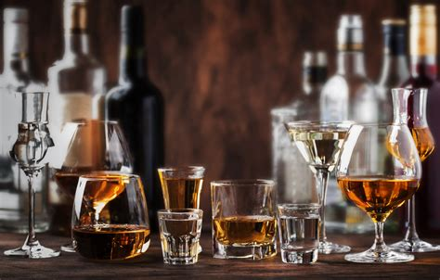
Alcohol Sales in Texas
Christopher Barraza
David James
Victoria Munoz
Jordan Tellez

Slide 2
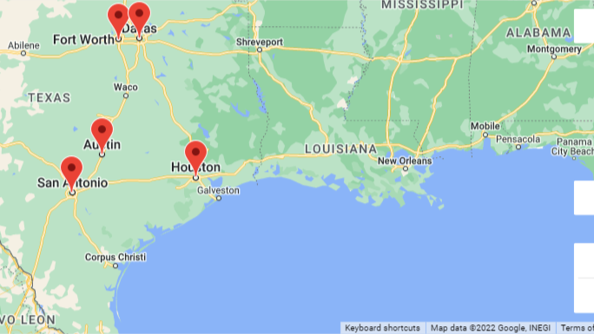

Slide 3
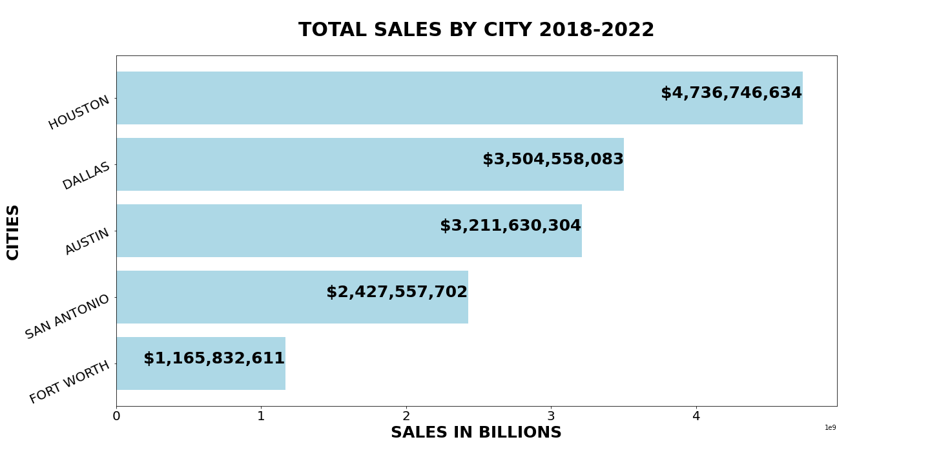
Sales By City

Slide 4
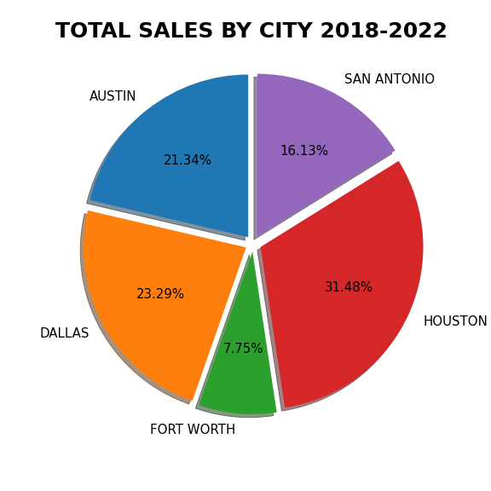
Sales By City

Slide 5
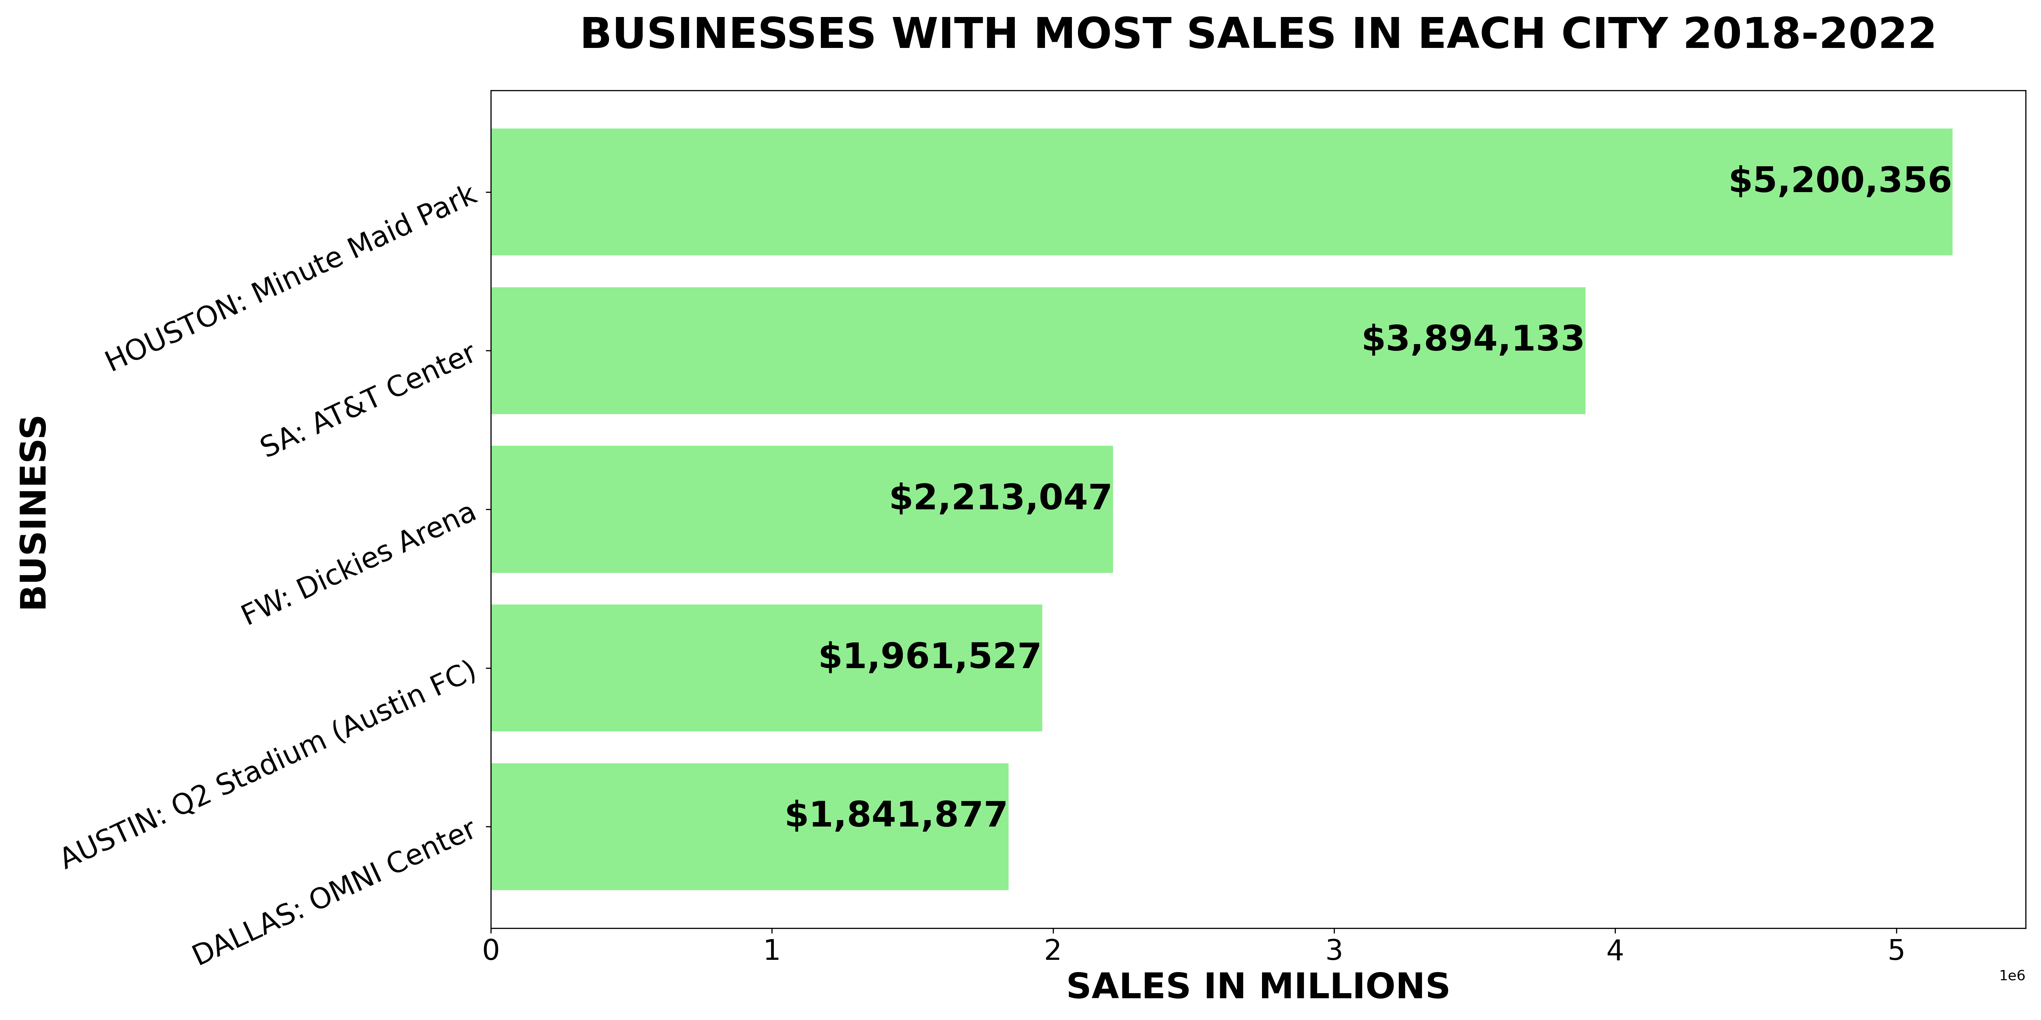
Max Sales Per Business By City

Slide 6
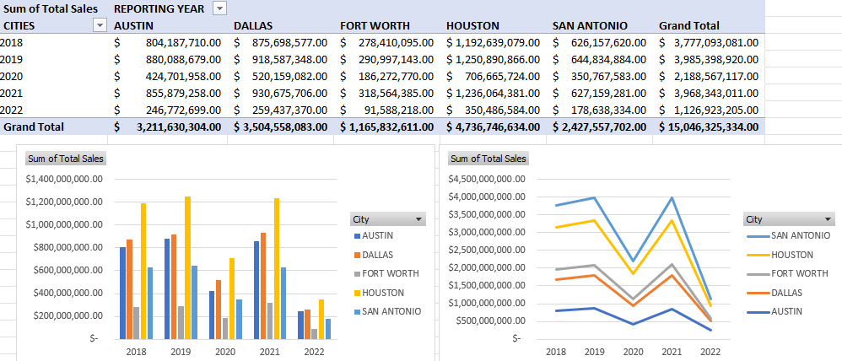

Slide 7
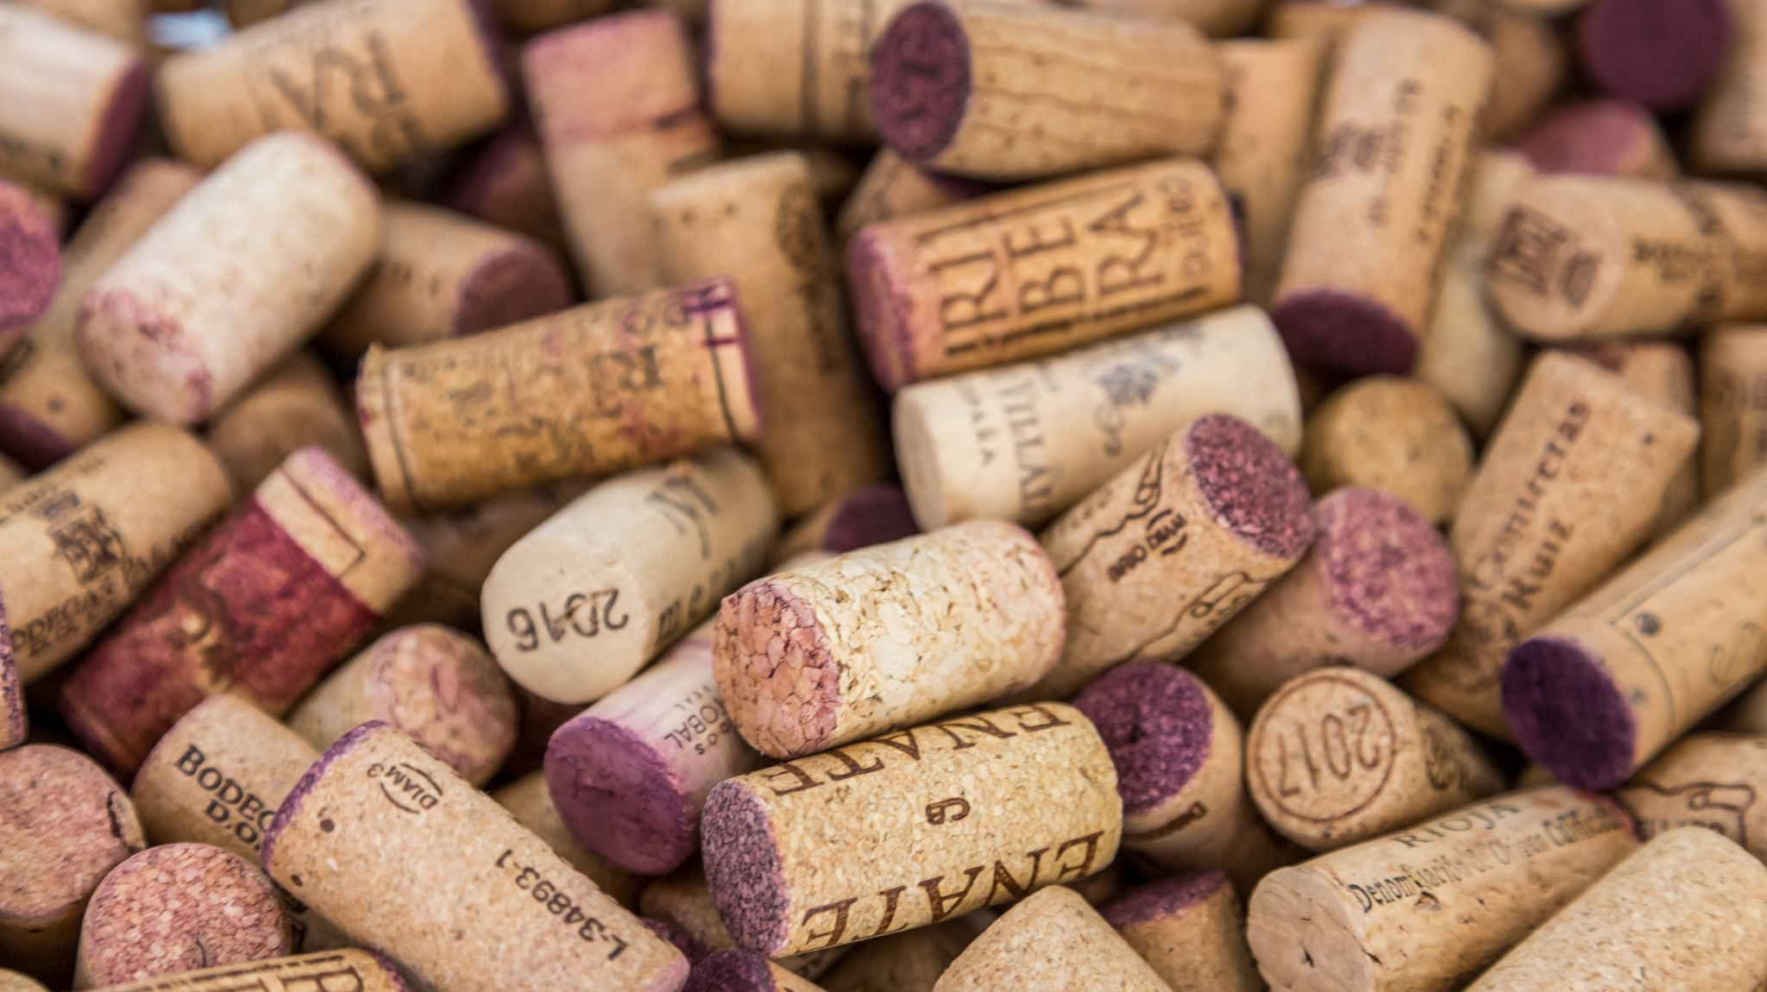
Wine Sales

Slide 8
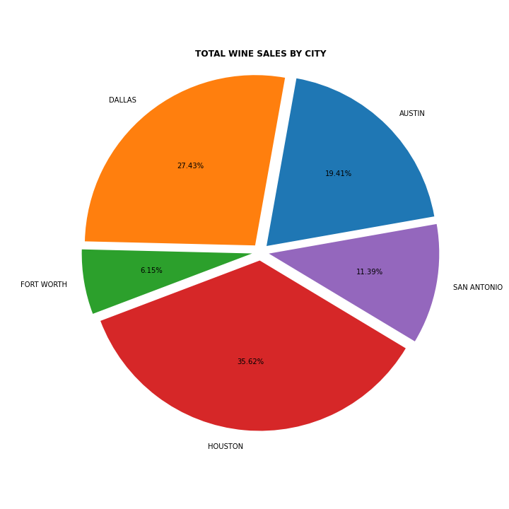
Wine Sales By City

Slide 9
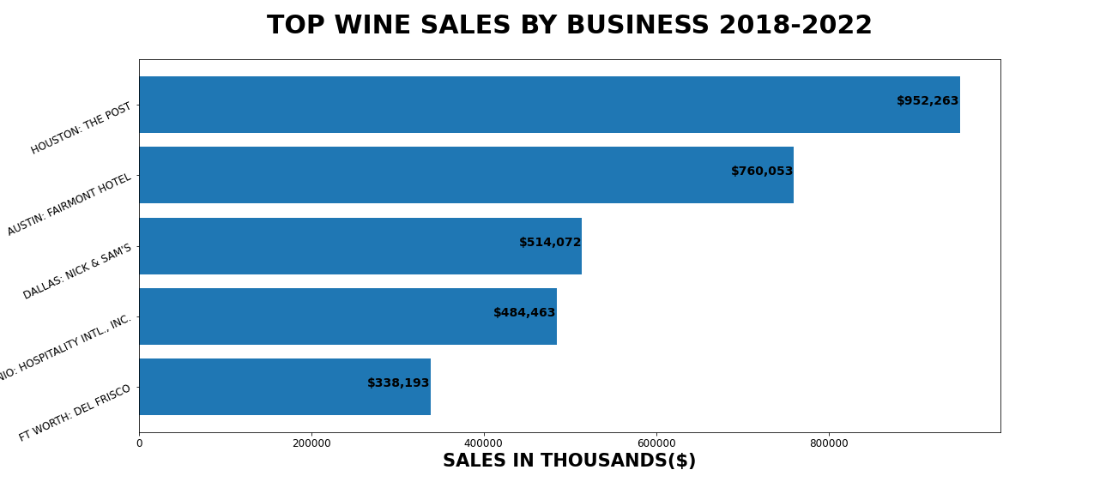
Wine Sales By Business

Slide 10
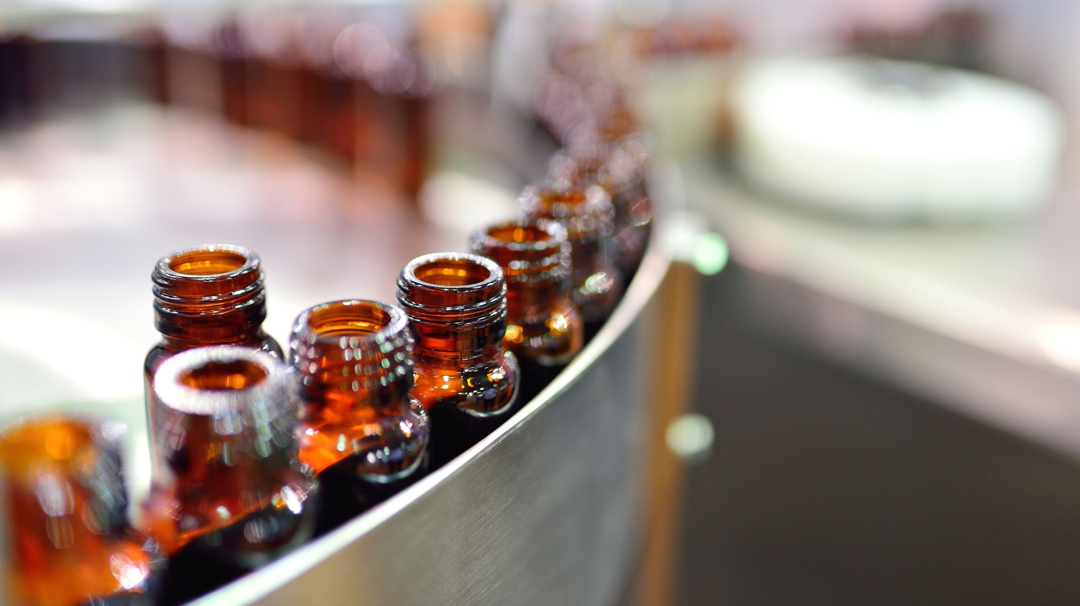
Beer Sales

Slide 11
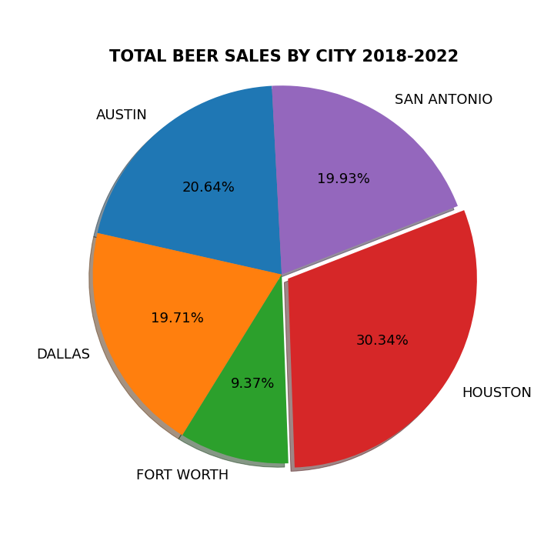
Beer Sales By City

Slide 12
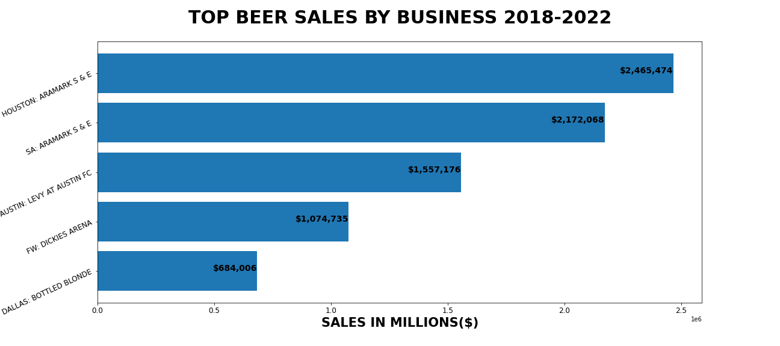
Beer Sales By Business

Slide 13
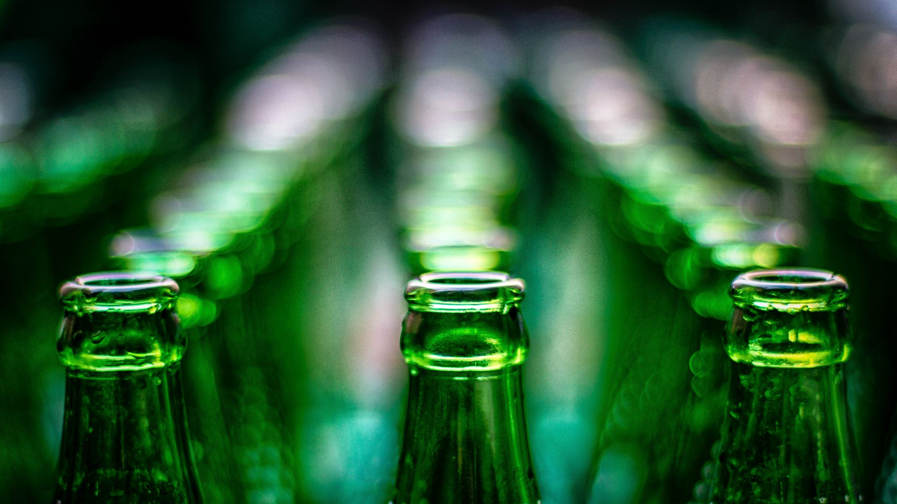
Liquor

Slide 14
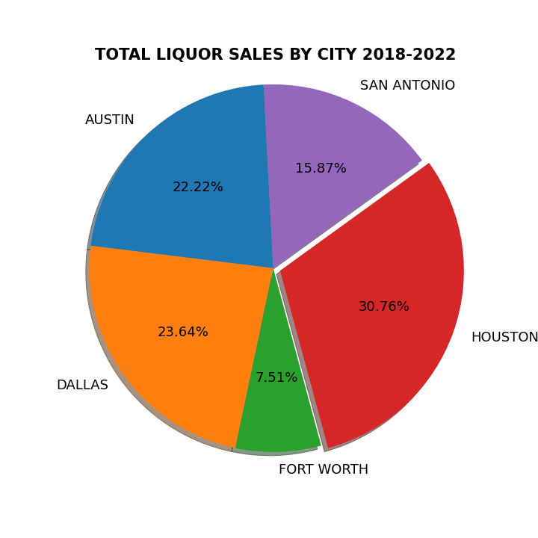
Liquor Sales By City

Slide 15
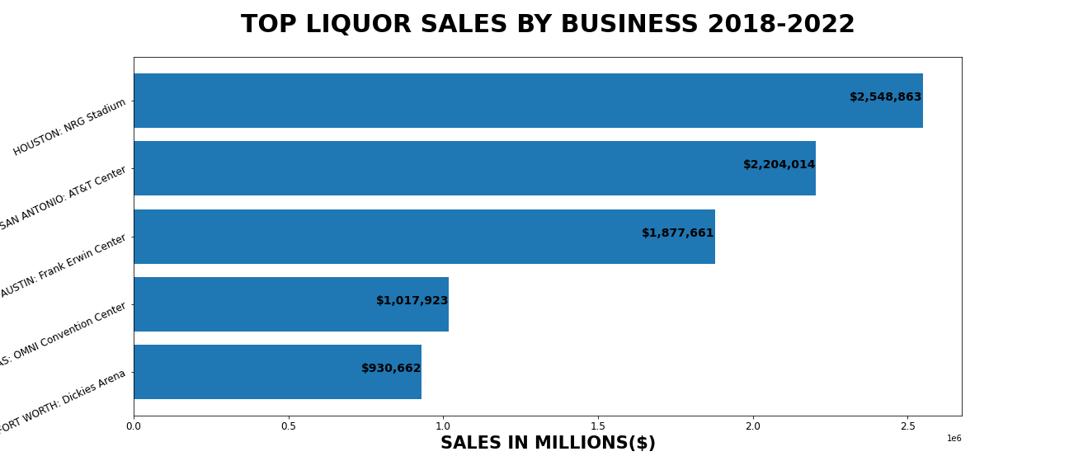
Liquor Sales By Business

Slide 16
Study Limitations
A population by age study researching the effects age plays a role on sales(Census API)
Alcohol sales by type of business(restaurant, bar, club, etc.) by using the ‘Yelp API’
Line graph showing the sales per city over the 4 year period(2018-2022)
Accomplished using excel pivot and charts
Individual sales per grouping(liquor, beer, wine) on which individual brand sold the most per city(e.g. Bud light, Miller light, Guinness) or domestic vs. imports.
What can this information be useful for if we were in the real business world
Trends as far as Holidays / Special Events go for Alcohol Sales increases or decreases

